Slide 1
Lesson 2
Software Engineering Best Practices: Action in Accord with All the Laws of Nature
Notes:
8-20-04
Removed a group of slides to 04fallDiscards

Slide 2
Topics: Principles of Software Engineering
The inherent challenge of software engineering
The importance of analysis and design
Best practices

Slide 3
Software Development Situation Analysis
"Studies have shown that for every six new large-scale software systems that are put into operation, two others are canceled. The average software development project overshoots its schedule by half; larger projects generally do worse. And some three quarters of all large systems are "operating failures" that either do not function as intended or are not used at all." (W.W. Gibbs, "Software's Chronic Crisis", Scientific American, Sept., 1994)
"Much of our software is delivered late, over budget, and with residual faults. Software engineering is an attempt to solve these problems. In other words, software engineering is a discipline whose aim is the production of fault-free software, delivered on time and within budget, that satisfies the user's needs. Furthermore, the software must be easy to modify when the user's needs change.." (Schach, Classical and Object-Oriented Software Engineering (4th Ed.), 1999, p. 4)
Notes:
The good news for software professionals is that worldwide economies are becoming increasingly dependent on software. The kinds of software-intensive systems that improvements in technology make possible, and that society demands, are expanding in size, complexity, distribution, and importance. In the US alone, we spend more than $250 billion each year on IT application development of approximately 175,000 projects (Source: Chaos Report, http://www.standishgroup.com).
The bad news is that these systems are expanding in size, complexity, distribution, and importance, for it pushes the limits of what we in the software industry know how to do. Poor quality software is becoming more visible. We often read about it in the newspaper! Some significant examples include:
AT&T. A software switching system failed and hindered long distance communication in the US for almost 24 hours. The resolution required a change to a single line of code.
Denver Airport. Software defects delayed the airport’s opening almost 9 months, at an estimated taxpayer cost of about 1/2 million dollars / day.
Further compounding the problem, businesses continue to demand increased productivity and quality with faster development and deployment. Additionally, the supply of qualified development personnel is not keeping pace with the demand. 1998 estimates of open software jobs range from 200,000 to 400,000. Economists predict that another million new programmers will be needed within the next nine years.
We’re really talking about the software crisis here. Everyone knows that the demand for software is outstripping the supply.

Slide 4
Software “Engineering” Has Special Challenges
“Software engineering is concerned with the theories, methods, and tools which are needed to develop software. In most cases, the software systems that must be developed are large and complex systems. They are also abstract in that they do not have any physical form. Software engineering is therefore different from other engineering disciplines. It is not constrained by materials governed by physical laws or by manufacturing processes.
"Software engineers model parts of the real world in software. These models are large, abstract and complex so they must be made visible in documents such as system designs, user manuals, and so on. Producing these documents is as much part of the software engineering process as programming. As the real world that is modeled changes, so too must the software. Therefore, software engineering is also concerned with evolving these models to meet changing needs and requirements." (Sommerville, Software Engineering (5th Ed.), 1996, p.4))

Slide 5
The Need for a Software Engineering “Process”
"The software problem boils down to the difficulty developers face in pulling together the many strands of a large software undertaking. The software development community needs a controlled way of working. It needs a process that integrates the many facets of software development. It needs a common approach, a process that
    Provides guidance to the order of a team's activities.
    Directs the tasks of individual developers and the team as a whole.
    Specifies what artifacts should be developed.
    Offers criteria for monitoring and measuring a project's products and activities.
"The presence of a well-defined and well-managed process is a key discriminator between hyperproductive projects and unsuccessful ones." (Jacobson, The Unified Software Development Process, 1999, pp.3-4)

Slide 6
No Silver Bullet
Essence: intrinsic nature
Accident: not intrinsic
  E.g., syntax of programming languages
Major advances already made for accidental aspects
  High level languages
  Time sharing (vs batch programming)
  Software development environments
Notes:
(Fred) Brooks: “No Silver Bullet”
About Fred:
Famous for his work on o/s at IBM, phd in applied math (comp sci) from Harvard, created his own comp sci dept at university of NC, Chapel Hill. One of his most famous essays was No Silver Bullet.
– accidents (like syntax of programming languages) we can change, but brooks asserts they have largely been done, e.g., 3 major breakthroughs
* hi level languages
* time sharing
* sw development environments
keith levi:
I.e., no simple answers

Slide 7
Essential Difficulties
Complexity
  Combinatorial complexity of states and processes
  Sheer size
  Interactive, distributed, networked
Conformity
  Expect software to conform to needs of hardware and business domains, even if a more "logical" approach would involve changing these external interfaces
Notes:
– complexity
* combinatorial complexity of huge number of potential states and processes
* sheer size of modern programs (e.g., windows – 10’s of millions of lines: lots of bugs)
* modern gui systems and networked/distributed systems very complex interactions
– conformity
* since sw easy to modify, tend to expect it to conform to hardware and existing system procedures, vs engineering system to simplify software

Slide 8
Essential Difficulties (cont)
Changeability
  Expect to modify incredibly complex systems
  Many pressures to modify software: reality changes, functionality extensions, easier than hardware, lasts longer
Invisibility
  Software is abstract compared to to buildings, bridges, …
  Difficult for visual diagrams to capture
Notes:
– changeability
* expect to be able to make modifications to incredibly complex systems and still have them all work
* will always be pressures to change sw
* reality (requirements) changes
* extensions to functionality needed
* easier to change than hw
* lasts longer than hw
– invisibility
* sw is abstract relative to most engineered systems such as buildings, bridges, molecules, silicon chips,…
* very difficult for visual diagrams to embody all aspects of a sw product
* (actually, are making some progress in this area, and will be emphasizing techniques like this)

Slide 9
Topics: Principles of Software Engineering
The inherent challenge of software engineering
The importance of analysis and design
Best practices
Notes:
•

Slide 10
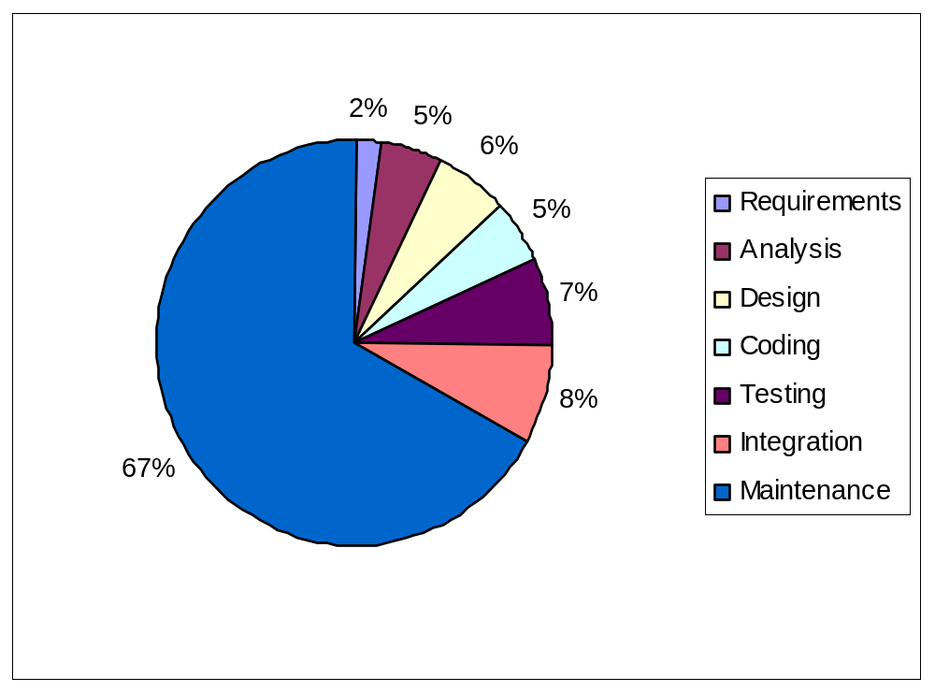
Importance of Maintainability
2/3 of life-cycle cost is in system maintenance (for successful projects)
Only about 5% total costs for coding
Notes:
fig 1.2 (schach)
Importance of maintainability
– 2/3 of life-cycle cost is in system maintenance (for successful projects)
– fig 1.2: standard phases and relative costs
* 18% corrective
* 18% adaptive—new requirements
* 60% perfective—optimizations, new functionality, …
Relative importance of “coding”
– note that of time spent in “implementation” phase, less than ¼ (5% total) is in writing code
– pt: professional sw engineer must know great deal more than just coding

Slide 11
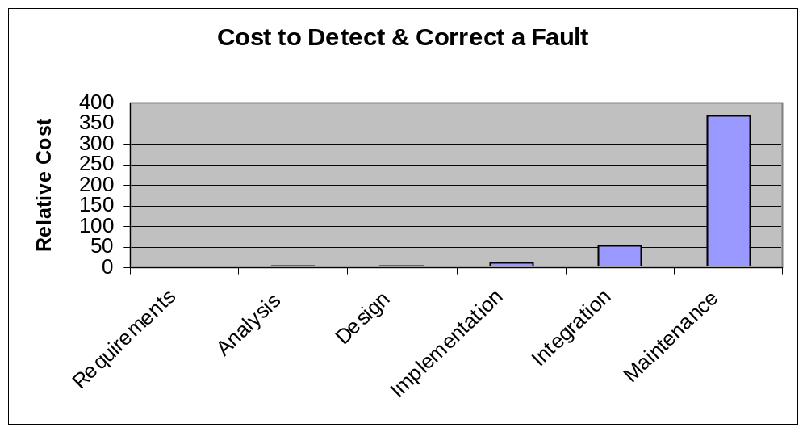
Importance of a Good Start
Fixing faults is much cheaper earlier in life-cycle than later
60-70% faults in large projects specification/design faults.
  Good A&D facilitate integration and maintenance
  Greatest potential area for improvement and payback
Notes:
(“well begun is half done”)
figs 1.4,5
Importance of a good start (“well begun is half done”)
– cost of fixing faults is much smaller if fixed earlier in life-cycle than later
– figs 1.4,5
– further, studies have shown that 60-70% of faults in large projects are specification or design faults.
– good analysis and design will facilitate integration and maintenance
Hence, this is the greatest area for improvement and payback from more attention

Slide 12
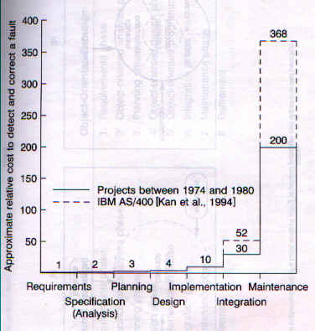
Increasing Costs to Detect and Correct Faults

Slide 13

Summary Points
Efficient development of quality software in a timely manner is inherently difficult
Two-thirds of all the faults in large scale projects have been observed to be specification or design faults. Two-thirds of the life-cycle costs of a software system are incurred during the maintenance phase.
Spec and design faults
Maintenance costs

Slide 14
Topics: Principles of Software Engineering
The inherent challenge of software engineering
The importance of analysis and design
Best practices
Notes:
•

Slide 15
Greatest Potential (Brooks)
Rapid prototyping
Incremental development
Develop great designers
Notes:
Brooks concludes hard part of building sw lies in the requirements, specs, and design work, not in implementation. His targets for most significant improvement
– rapid prototyping
– incremental development
– training and encouraging great designers
– will see all of these prominent in most modern sw eng practices

Slide 16
Value of OO Techniques
Widely accepted in the field as supporting good software engineering principles and practices
Analysis and design closely integrated with implementation
  Directly addresses 60-70% faults in specs and design
Objects support greater integrity of software components
  Encapsulate implementation details
  Leads to reusability, extensibility, and maintainability
  Addresses other area of maximum potential payback (maintenance)
Notes:
• Object oriented technologies now widely accepted in the field as supporting good software engineering principles and practices
• One key feature of oo methodologies is that analysis and design are closely integrated with implementation
– directly addresses the point that 60-70% of faults are in specs and design (if too great a transition from design
to implementation, errors more likely
• Another key feature of oo methodologies is that objects support greater integrity of software components (e.g., objects encapsulate implementation details; use of inheritance, polymorphism, dynamic binding; patterns, frameworks, etc) which (when properly implemented) leads to reusability, extensibility, and maintainability
Note: oo supports the engineering paradigm for building software: reusable components woven together, communicating via public interfaces

Slide 17

Unified Process Delivers Best Practices
Develop Iteratively
Use
Component
Architectures
Manage
Requirements
Model
Visually
Verify
Quality
Control Changes
Notes:
Manage requirements and model visually – handles the 66% of commonest errors, and addresses Brooks’ intrinsic problem concerning complexity
Use Component Architectures – again, manage complexity
Develop iteratively, again manage complexity
Verify quality and control changes – maintenance and manage complexity
This ties the process back to the 6 best practices already covered. The 6 best practices are embodied in the process. The process provides direction on how to apply the 6 best practices throughout the life cycle.
Rational Unified Process describes how to effectively implement the six best practices for software development

Slide 18
Visually Model Software
Addresses one of Brooks’ “essential” difficulties (inherent abstractness of software)
Helps to visualize, specify, construct and document structure and behavior of a system
Using a standard modeling language (like UML) helps to maintain consistency among system’s artifacts and facilitates communication among team members
K12-13
Notes:
A model is a simplification of reality that provides a complete description of a system from a particular perspective. We build models so that we can better understand the system we are modeling
Visual modeling for software is analogous to blueprints for construction.

Slide 19

What Is the UML?
The Unified Modeling Language (UML) is a language for
    Specifying
    Visualizing
    Constructing
    Documenting
the artifacts of a software-intensive system
Notes:
Specify: provides a number of diagram types, used for certain well-defined purposes
Visualizing: models are sketches or diagrams
Constructing: models are used both as a guide to implementation, but also may be used to generate code – even can be used as a programming language itself
Documenting: UML models are part of the standard documentation for large systems
The RUP is based on the UML, so we first discuss the UML and then explain what the UML does NOT provide. The RUP fills in the gaps.
keith levi:
unchanged

Slide 20
Inputs to UML
Booch
Rumbaugh
Jacobson
Meyer
Fusion
Before and after
conditions
Operation descriptions,
Message numbering
Embley
Harel
Singleton classes,
High-level view
State charts
Gamma, et.al
Wirfs-Brock
Frameworks, patterns,
notes
Responsibilities
Shlaer - Mellor
Odell
Object Lifecycles
Classification
Notes:
Timeline:
-- 80’s - OO was born in C++ and Smalltalk
- led to oo graphical design languages
- Booch – Booch method,
– Rumbaugh- OMT (Object Modeling Technique)
- Jacobson – OOSE (OO Sofware Engineering)
1995 – OMG (object management group) facilitated an alliance with these
three, and the integration of their methods resulted in UML
Again, this is a slide you do not need to spend a lot of time on. You might just want to point out one or two contributors of special interest to your audience. For example, for a telephony audience, you might point out Harel and his state charts.
keith levi:
unchanged

Slide 21
The UML Provides Standardized Diagrams
Models
Use Case
Diagrams
Activity
Diagrams
Class
Diagrams
Object
Diagrams
State
Diagrams
Sequence
Diagrams
Collaboration
Diagrams
Deployment
Diagrams
Component
Diagrams

Slide 22
Best Practices Address Root Causes
Visually model software
Develop software iteratively
Use component-based architectures
Manage requirements
Verify software quality
Control changes to software
K5-6
Notes:
We will show this list of root causes many times throughout the course. Within each of the individual best practices modules, we identify how each root cause is cured by that best practice.

Slide 23
What Is a Software Development Process?
A software development process is the set of activities needed to transform a user’s requirements into a software system. The process defines Who is doing What, When, as well as How to reach a certain goal.
Software Development
Process
User
Requirements
Software
System
J4
Notes:
Specifies role (who) and activities for the role (what).
Also, the role becomes significant at certain times (when) in the lifecycle.
How to reach the goal – project management.
It can be very difficult to explain what a process is, if people aren’t already familiar with it. An informal example most people can relate to is the process of balancing a checkbook at the end of the month. Most of us have developed a process we use - the same steps every month. It shortens the time required to accomplish the task and ensures that we don’t forget any steps. The same applies to a software engineering process. We want it to be repeatable and ensure that all required tasks are accomplished when required. Of course, a software engineering process is much more complex than balancing a checkbook and there is a tremendous amount of information contained in the RUP.

Slide 24
RUP Key Features
Use case driven
Iterative and incremental
  Models, workflows, phases, and iterations
Architecture centric
Notes:
We study RUP. It provides detailed instructions for how to put into practice Rationals 6 best practices (
Visually model, develop iteratively, control change, manage requirements, use component based arch
This is a good opportunity to contrast the RUP with old-fashioned processes. RUP is meant to be used on a daily basis. It is relevant because it is integrated with the tools the developer is using. It is easy to access since it is on the desktop.
Emphasize that the process contains far more information than any one person can remember. It is not intended that they learn it all at once. The best approach is to first get an overview so that they understand how it is organized and where to look for things. Then access the online process to learn the details of each task as they need to perform the task.

Slide 25
Rational Unified Process Is Use-Case Driven
An actor is someone or something outside the system that interacts with the system
A Use-Case is a sequence of actions a system performs that yields an observable result of value to a particular actor
Transfer Money
Customer
Check Balance
Withdraw Money
Use-Cases for an Automated Teller Machine
Notes:
· Use Cases <->Managing requirements
· Capture requirements in a use case model.
· Use cases drive development and testing.
· An actor can be a human being or another system or a device; anything external with which the system interacts.
· A Use-Case describes functionality from the user’s point of view.
· The collected Use-Cases constitute the use-case model and represent all the possible ways of using the system. The use-case model is a model of the system’s intended functions and serves as a contract between the customer and the developers.
· The use-case model is complemented by non-functional specifications covering some of the aspects that cannot be easily conveyed by a Use-Case, or that apply to many or all Use-Cases; for example, high-level product requirements, development constraints, safety or security attributes, and so on.
· The notation used for representing the use-case model in diagrams is standard notation provided by the UML.
The goal of the next few slides is to give students an overall understanding of what it means to say that the RUP is use-case driven, without getting bogged down into the details of use-case development. Only the most basic terminology and symbols are used.
The example model is incomplete. You might ask students what other Use-Cases they would expect a cash machine to provide.

Slide 26
Use-Cases Include a Flow of Events
Flow of events for the Withdraw Money Use-Case
  1. The Use-Case begins when the client inserts an ATM card. The system reads and validates information on the card.
  2. The system prompts for the PIN. Client enters PIN. The system validates the PIN.
  3. The system asks which operation the client wishes to perform. Client selects “Cash withdrawal.” System requests amount.
  4. Client enters amount. System requests the account type.
  5. Client selects account type (checking, savings, credit). The system communicates with the ATM network . . .
Notes:
Flow of events is detailed in the Use Case description. The overview of all the use cases and actors is shown in the Use Case diagram.
The example is incomplete. Just enough steps are provided to illustrate the simplicity and informality of this approach.

Slide 27
Benefits of a Use-Case Driven Process
Use-Cases are concise, simple, and understandable by a wide range of stakeholders
  End users, developers and acquirers understand functional requirements of the system
Use-Cases drive numerous activities in the process:
  Creation and validation of the design model
  Definition of test cases and procedures of the test model
  Planning of iterations
  Creation of user documentation
Use-Cases help synchronize the content of different models
Notes:
Issue: how do technical developers communicate with non-technical stakeholders? Use cases provide a medium
2. – creation and validation of design model – can see whether design will meet the specs laid out in use cases
-- def of test cases – each use case represents a group of tests
-- planning of iterations – we’ll talk about iterations more later, but critical or risky use cases are implemented first
-- user documentation – use cases provide a first cut at user doc
The important point to get across is that Use-Cases permeate all parts of RUP and are a key mechanism in accomplishing the Managing Requirements best practice.
keith levi:
unchanged

Slide 28
RUP Key Features
Use case driven
Iterative and incremental
  phases, iterations, and workflows
Architecture-centric
Notes:
The focus of the process is the production of high-quality executables with a minimum of overhead, rather than what documents to produce.
By providing a “written-down”, very detailed set of procedures for developing software according to Rational’s six best practices, the process is easier to apply and repeatable. This results in software projects that are more predicable and successful.
Another feature of the Rational Unified Process is that it is not just theory. It instructs the developer on how to implement the activities using the tools the developer is using.
Finally, the process is available on-line as a Website. While hardcopy books have their place, most developers prefer to reference the process from their desktops when they need help. Both hardcopy and on-line versions are available.
This is a good opportunity to contrast the RUP with old-fashioned processes. RUP is meant to be used on a daily basis. It is relevant because it is integrated with the tools the developer is using. It is easy to access since it is on the desktop.
Emphasize that the process contains far more information than any one person can remember. It is not intended that they learn it all at once. The best approach is to first get an overview so that they understand how it is organized and where to look for things. Then access the online process to learn the details of each task as they need to perform the task.

Slide 29
Develop Software Iteratively
An initial design will likely be flawed with respect to its key requirements
Late-phase discovery of design defects results in costly over-runs and/or project cancellation
Notes:
A) Not all requirements are initially known,
b) those that are known may be ambiguous or simply wrong.
C) Some requirements that are initially accurate will become obsolete because the problem domain or competitive situation changes during development
2. Better to find design flaws early in process – iterative approach supports
keith levi:
unmodified rational

Slide 30
Traditional Waterfall Development
Requirements
Analysis
Design
Code & Unit
Testing
Subsystem
Testing
System Testing
T I M E
Notes:
Software has been developed using the waterfall model for more than 30 years. The concepts are familiar to most developers and most project plans are developed with the waterfall in mind. The basic concept is that the entire system goes through the phases linearly and in lock step. First all the requirements are defined, then the design is completed. Finally, code is written and tested. The key assumptions are that when design begins, requirements no longer change. When coding starts, the design ceases to change. These assumptions are, of course, incorrect. Hence problems result and software is late, over budget, and/or unacceptable.
To illustrate a problem with the waterfall model: Suppose you estimate that the project will take 2 years and it really takes 3 years. At the end of 2 years what do I have? Nothing useful works. I have nothing that could be delivered as an early (partial) release. Diagrams and models are great, but they can’t execute.
keith levi:
unmodified rational

Slide 31
Waterfall Development Delays Reduction of Risk
Requirements
Analysis
R
I
S
K
Design
Code & Unit
Testing
Subsystem
Testing
System Testing
T I M E
K6-7
Notes:
The fundamental problem of this approach is that it pushes risk forward in time, where it’s costly to undo mistakes from earlier phases. An initial design will likely be flawed with respect to its key requirements, and furthermore, the late discovery of design defects tends to result in costly over runs and/or project cancellation. The waterfall approach tends to mask the real risks to a project until it is too late to do anything meaningful about them.
To continue the example. At the end of two years, since we have not actually executed any thing yet, we have just as much risk remaining in the project as we had when we started.
Animation note: the green line is drawn automatically.
keith levi:
unmodified rational

Slide 32
Apply the Waterfall Iteratively to System Increments
Iteration 1
Iteration 2
Iteration 3
R
R
R
D
D
D
C
C
C
T
T
T
T I M E
Earliest iterations address greatest risks
Each iteration produces an executable release, an additional increment of the system
Each iteration includes integration and test
Notes:
R: Requirements Analysis
D: Design
C: Coding, Unit Testing
T: Subsystem and System Test
Iterative processes were developed in response to these waterfall characteristics. With an iterative process, the waterfall steps are applied iteratively. Instead of developing the whole system in lockstep, an increment (that is, a subset of system functionality) is selected and developed, then another increment, etc. The selection of the increment to be developed first is based on risk, the highest priority risks first. To address the select risk(s), a subset of use-cases are chosen. The minimal set of use-cases that will allow objective verification (i.e., through a set of executable tests) that this risk has been addressed, is developed. Then the next increment is selected to address the next highest risk, and so on. The waterfall is thus applied at the increment level and the system evolves incrementally.
In the iterative approach, the waterfall is applied to a single increment of the system at a time. Each iteration produces an executable.
Animation note: The graphic automatically wipes right
keith levi:
unmodified rational

Slide 33
Iterative Development Accelerates Risk Reduction
R
I
S
K
Iterative
Waterfall
Iteration
Iteration
Iteration
Iteration
Iteration
Iteration
Iteration
T I M E
Notes:
The most critical characteristic of iterative development is that project risk is driven down in early iterations before significant implementation investments are made.
Going back to our 2-year project that actually takes 3 years: It may still take 3 years, but at the end of 2 years, we have removed most of the risk and have something that executes, although in a limited way. We are in a much stronger position.
Animation notes: The risk lines are automatically drawn after the axes are drawn.
keith levi:
unmodified rational

Slide 34
Lifecycle Phases
Inception
Elaboration
Construction
Transition
time
The Rational Unified Process has four phases:
  Inception - Define the vision and scope of project
  Elaboration - Plan project, specify features, baseline architecture
  Construction - Build product
  Transition - Transition product to users
K60
Notes:
Inception
scope (actors and essential uses cases (20%))
business plan – decision whether to invest in project
Elaboration
goals: get a good grasp of the requirements (90% complete) and establish an architectural baseline
this reduces risk, clarifies details
detailed cost estimates can be made at end
Construction
we build the product in several iterations up to a beta release.
During Transition
we transition the product to the end user and focus on end user training, installation, and support.
The student notes are quite extensive. There is no need to go into that much detail in class. The important thing is to understand how the RUP uses phases to organize the life cycle.
You can also mention that we deliberately chose names that do not match the waterfall names (analysis, design, implementation, and test) to emphasize that they are NOT the same as the waterfall phases.
Some ways of describing the phases in common terminology:
Inception - bid and proposal
Elaboration - Building blueprints
Construction - I think I’m done
Transition - how do users react?

Slide 35
Phase Milestones
Inception
Elaboration
Construction
Transition
time
Life-cycle
Objective
Milestone
Life-cycle
Architecture
Milestone
Initial Operational
Capability
Milestone
Product
release
K60
Notes:
At each of the major milestones,the project is reviewed and a decision made as to whether to proceed with the project as planned, to abort the project, or to revise it. The criteria used to make this decision vary by phase.
The evaluation criteria for the inception phase (LCO) include: stakeholder concurrence on scope definition and cost/schedule estimates; requirements understanding as evidenced by the fidelity of the primary Use-Cases; credibility of cost/schedule estimates, priorities, risks, and development process; depth and breadth of any architectural prototype; actual expenditures versus planned expenditures.
The evaluation criteria for the elaboration phase (LCA) include: stability of the product vision and architecture; resolution of major risk elements; adequate planning and reasonable estimates for project completion; stakeholder acceptance of the product vision and project plan; acceptable expenditure level.
The evaluation criteria for the construction phase (IOC) include: stability and maturity of the product release (I.e., is it ready to be deployed?); readiness of the stakeholders for the transition; acceptable expenditure level.
At the end of the transition phase, a decision is made whether to release the product. This will be based primarily on the level of user satisfaction achieved during the transition phase. Often this milestone coincides with the initiation of another development cycle to improve or enhance the product. In many cases, this new development cycle may already be underway.
The student notes are extensive and there is no need to go into detail with each milestone. The most important point to get across is that there are formal milestones marking major decision points with the RUP lifecycle just like there is in the waterfall.
The criteria listed in the student notes are extensive because they are thorough. However, only one or two of the criteria at each point are really important. The ones to emphasize are:
LCO: scope agreed upon and risks understood and reasonable
LCA: high risks addressed and architecture stable
IOC: product is complete and quality acceptable

Slide 36
Iterations and Phases
Each phase consists of one or several iterations.
Inception
Elaboration
Construction
Transition
time
Iteration
#1
Iteration
#2
Iteration
#3
Iteration
#4
Iteration
#5
Iteration
#6
Iteration
#7
Iteration
#8
Internal
Release
Minor
Milestone
First External
Release
(e.g., “beta”)
Final
Release
K62, J9
Notes:
Within each phase, there is a series of iterations. The number of iterations per phase will vary. Each iteration results in an executable release encompassing larger and larger subsets of the final application.
An internal release is kept within the development environment and (optionally) demonstrated to the stakeholder community. An external release is provided to stakeholders (usually users) for installation in their own environment. External releases are much more expensive (they require user documentation and technical support) and normally occur only during the transition phase.
The end of an iteration marks a minor milestone. It is a point in time when technical results are assessed and future plans revised as necessary.

Slide 37
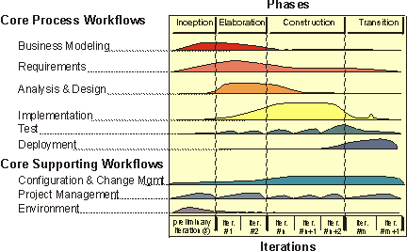
Overall Architecture of the Rational Unified Process
K45, J11
Notes:
Graphs show how much time is spent on each workflow in the different phases
Bus Modeling: what bus processes are, and bus environment- business use case model
Requirements: what system is supposed to do – use case model
Analysis and Design: results in models that define the design of the system to be built
Implementation: coding of the design
Test: test cases and procedures for validating
Deployment: put into production
Each iteration involves activities from all workflows. The relative amount of work related to the workflows changes between iterations. For instance, during late Construction, the main work is related to Implementation and Test and very little work on Requirements is done.
Note that requirements are not necessarily complete by the end of Elaboration. It is acceptable to delay the analysis and design of well-understood portions of the system until Construction because they are low in risk.
Can iterations overlap?
No. Our model is to show no overlap among iterations. In a large project, several teams may work in parallel on their portions of the iteration, but we do not consider these to be separate iterations.
How many iterations should you have?
It depends on many factors. Err on the side of too many iterations.
Animation note: The callouts and black rectangle appear 2 seconds after the slide.
REF: actually this came from the rational white paper

Slide 38
Benefits of Iterative Development
Serious misunderstandings become evident early in the life cycle
Enables and encourages user feedback
Development focuses on critical issues
Objective assessment thru testing
Inconsistencies detected early
Workload of teams is spread out
Leverage lessons learned earlier
Stakeholders are kept up to date on project’s status
K8
Notes:
Iterative development enables and encourages user feedback, so as to elicit the system’s real requirements.
Serious misunderstandings are made evident early in the lifecycle, when it’s possible to react to them.
The development team is forced to focus on those issues that are most critical to the project, and are shielded from those issues that distract the team from the project’s real risks.
Continuous, iterative testing enables an objective assessment of the project’s status. This provides concrete evidence of status to all stakeholders all along the way.
Inconsistencies among requirements, designs, and implementations are detected early, when corrections can be made without jeopardizing the schedule.
Testing starts earlier in the life cycle, so testing is likely to be more thorough. The workload of the team, especially the testing team, is spread out more evenly across the lifecycle.
An iterative approach allows risks to be identified and addressed early in the schedule, when it is possible to pursue alternative solutions without jeopardizing the delivery date.
Don’t try to talk to all of the arrows on this slide (or the other 5 slides just like it). Pick one or two that are most important and elaborate.
Mike Robinson:
Done

Slide 39
RUP Key Features
Use case driven
Iterative and incremental
  Models, workflows, phases, and iterations
Architecture-centric
Notes:
This is a good opportunity to contrast the RUP with old-fashioned processes. RUP is meant to be used on a daily basis. It is relevant because it is integrated with the tools the developer is using. It is easy to access since it is on the desktop.
Emphasize that the process contains far more information than any one person can remember. It is not intended that they learn it all at once. The best approach is to first get an overview so that they understand how it is organized and where to look for things. Then access the online process to learn the details of each task as they need to perform the task.

Slide 40
Software Architecture Encompasses
Organization of a software system
Selection of the structural elements and their interfaces by which a system is composed
Their behavior, as specified in collaborations among those elements
The composition of these structural and behavioral elements into progressively larger subsystems
K9-10
Notes:
At this stage, sketch out the main components and their interfaces. Identify risk
Architecture is a part of design. Architecture is about making decisions on how the system will be built. But it is not all of the design. It stops at the major abstractions, the major elements, in other words, the elements that have some pervasive and long-lasting effect on the qualities of the system, namely its evolvability, its performance.
A software system’s architecture is perhaps the most important artifact that can be used to control the iterative and incremental development of a system throughout its life cycle.
An example of an architectural concern is an integration risk. For example, does database D work properly with operating system Y? Another example is performance risk. Can we compute the trajectory of the aircraft in the time allowed?
Because students vary in how familiar they are with the concept of architecture applied to software, it is best to get a sense of this from the students before beginning this section. If they are fairly unfamiliar, it helps to use the analogy to buildings or civil engineering. The more complex the building, the more critical a good architecture is. The longer you want the building to be useful, the more effort and expense you will put into the architecture. And in both of these cases, the choice of architect is critical.
keith levi:
edit bullets to p9 kruchton
Mike Robinson:
Done

Slide 41

Example: Component-Based Architecture
Lead Tracking
User Interface
Licensing
User Interface
User Interface
Mechanisms
Customer
Product
License
Key:
- Purchased
- Built
- New
Oracle
Vantive
K11
Notes:
This IS application displays an architecture that utilizes components. There is a pair of databases, access to which is mediated through purchased components. Built on this are custom-developed components that capture the organization’s semantics and business rules for Customers and Products.
There is a set of UI mechanisms, some of which were purchased and a user interface for Lead Tracking.
Suppose we wish in addition to institute and manage software licensing. First, we need a component to capture the business rules for licensing. Access requires a new GUI. As we are implementing the GUI, we encounter the need for additional UI Mechanism capabilities, satisfied by re-using an existing component and purchasing a new one.
This example should be familiar with most IS people. Even people who build embedded software should be able to relate to the infrastructure software within their own companies.
Most companies today use off-the-shelf purchased packages for as much of the functionality as possible, and fill in where the products are deficient. This example derives from an internal IT project at Rational.
Animation notes: Initially, all but the licensing application is shown. Explain that it is component based, some components purchased and some built. Then suggest we need to manage licensing and click the mouse to show the additional components and how existing ones are reused.
keith levi:
redraw own version
(mike already did?) Mike Robinson:
No, but this is just like Krutchten’s.

Slide 42
Benefits of using Component Architectures
Components facilitate resilient architectures
Modularity enables a clear separation of concerns among elements of a system that are subject to change.
Reuse is facilitated by leveraging standardized frameworks and commercially available components
K10-11
Notes:
Resilient architectures are important, since they enable economically significant degrees of reuse. Component-based development further enables reuse or customization of existing components or components from thousands of commercially available sources.
Modularity enables a clear separation of concerns among elements of a system that are subject to change.
Components provide a natural basis for configuration management, facilitating the incremental control of subsets of a system over many iterations. A component-based approach also permits modular creation of tests so that each component has an associated test suite and every time a component is reused, the tests can be rerun.
Visual modeling tools provide automated support for visualizing and communicating architectural decisions.
Coupled with the practice of developing software iteratively, using component-based architectures involves continuous evolution of a system’s architecture, with each iteration producing an executable architecture that can be measured, tested, and evaluated against the system’s requirements. This approach permits the development team to continuously attack the most important risks to the project.
Don’t try to talk to all of the arrows on this slide (or the other 5 slides just like it). Pick one or two that are most important and elaborate.
keith levi:
replace with 5 pts from K10-11
Mike Robinson:
Done

Slide 43
Review Questions
What are 3 “essential” difficulties in software development?
What phase of the lifecycle has the highest costs?
What phase introduces the most significant errors?
K13-14
Notes:
Don’t try to talk to all of the arrows on this slide (or the other 5 slides just like it). Pick one or two that are most important and elaborate.
keith levi:
replace from k13-14
Mike Robinson:
Done

Slide 44
RUP Review Questions
In what sense is RUP
  use-case driven?
  architecture-centric?
  iterative?
What are the RUP
  phases?
  workflows?
  Which workflows occur in which phases?
K13-14
Notes:
Don’t try to talk to all of the arrows on this slide (or the other 5 slides just like it). Pick one or two that are most important and elaborate.
keith levi:
replace from k13-14
Mike Robinson:
Done

